Slide 1
DAY 05
Important
Concepts
in
Python

Slide 2
Day 05
Important Concepts in Python
Python3 And Python2 Difference With Practical
Comments
Program & Statement
Terminator
Indentation

Slide 3
Difference Between Python2 & Python3
In Python2 print "hello world"
In Python3 print("hello world")
In Python2 int a = 5/2 ->2
In Python3 int a = 5/2 ->2.5
In Python2, raw_input()
In Python3, input()
In Python2, xrange method
In Python3, range method

Slide 4
Comments in Python
Comments
No Compile
For the developer not for the user
To write extra about code
To give extra information about the code
Advantages
Easy to understand
Good look
To avoid any execution of statement
Types Comments
Single-line Comment
# single line comment
Multi line Comment
“”” multi line comment “””

Slide 5
What is Program ?
Programs
A Set Of Instruction That Provided To Computer, According To That Instruction Computer Able To Do Work
That Set Of Instruction Called Program
With Program, Computer Understand That What To Do And How To Do
Computer Program Can Be Written Using Programming Language

Slide 6
What is Statement?
Statements
Statement is the complete action in the program
Statement may be a series of bits
We have to separate a statement using semicolon’;’ on single line
Statement are similar a sentence in the English
Statement may contain variables, I/O function, methods etc.

Slide 7
Statement Examples
Examples
name = “Faisal”
age = 30
print(“How are you")
print(name)
print(age)

Slide 8
Terminator / Separator
In the python, there is separator used to separate statement to each other.
The semicolon used as separator in python.
We can write multiple statement on the single
Examples:
print("Hi"); print("How“) # error free
print("Hi") print("How“) # give error

Slide 9
Terminator / Separator
There Is No Need To Use Terminator In Python
a = 45
b = 50
print('No Semicolons ; in the Python')
But In Another Programming Language Like C++
a = 45;
b = 50;
cout<<“There is Semicolons ; in the C++”;

Slide 10
Indentation in Python
Indentation Means A Properly Distance Between Statements
Using Indentation We Can Make A Specific Block Of Code
We Cannot Make A Group Of Statements Using Curly Braces In Function, Loop etc.
But We Will Used A Proper Indentation To Make A Group Of Statement In A Block
Raise Indentation Error
print()
print()

Slide 11
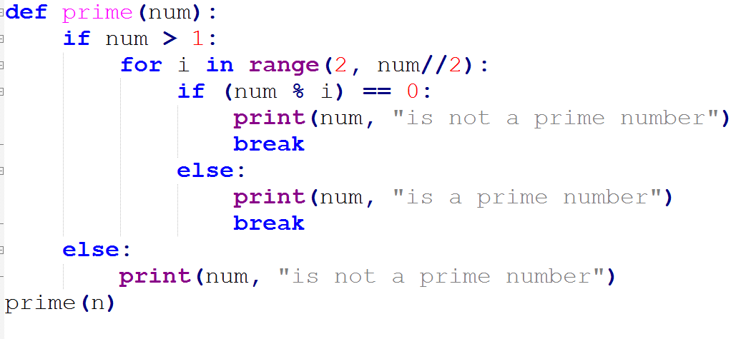
Indentation

Slide 12
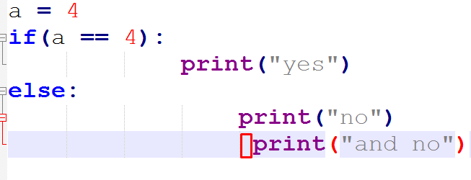
Indentation

Slide 13
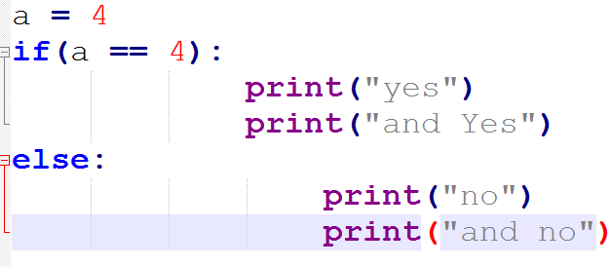
Indentation

Slide 14
Next Day 06
Variables
Rules To Declare A Variable
Declaration And initialization
What Is Expression
Undefined Variable
Types Of Variable Only

